Slide 1
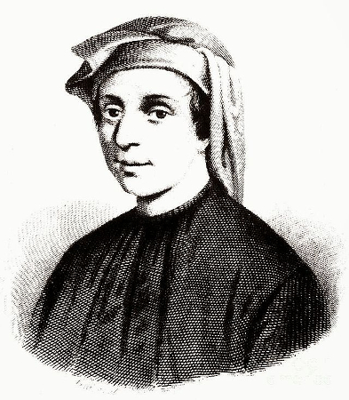
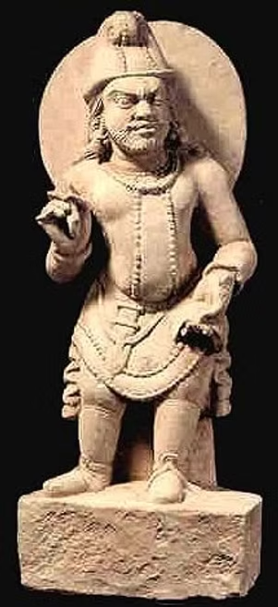
What’s Fibonacci Sequence?
Fibonacci Sequence And The Golden Rectangle
The Indian mathematician and poet Pingala, around the 2nd-3rd century BCE, is known for describing the Fibonacci sequence in his work Chandaḥśāstra(चंडशास्त्र)
By Shreyy Vinay Madgaonkar
Class:X Roll no:06
Formula:
Fn=Fn-1+Fn-2

Slide 2
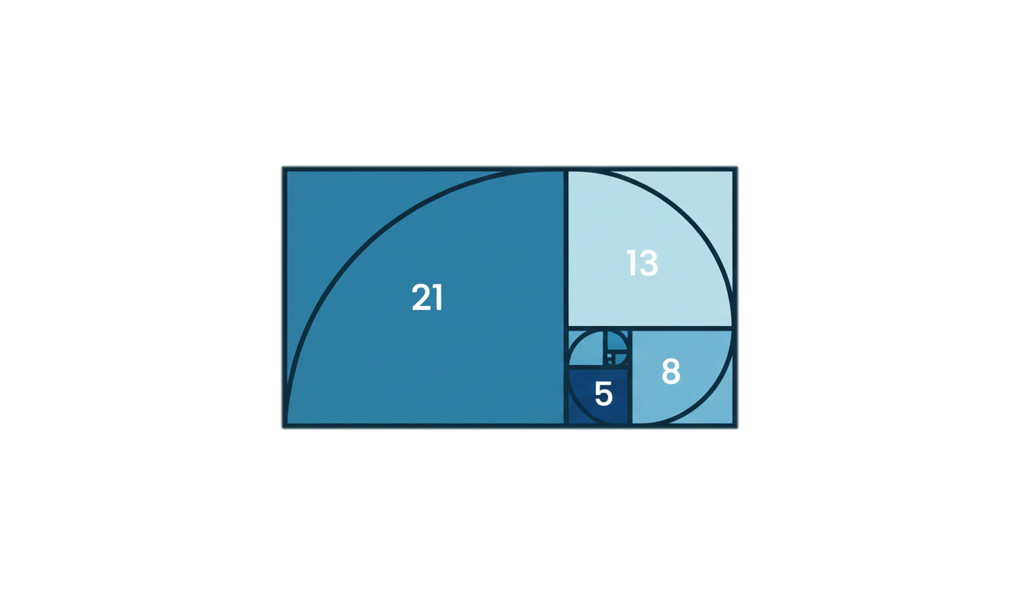
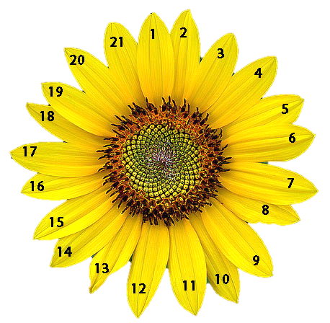
What’s Fibonacci Sequence?
The Fibonacci sequence arises from a classic rabbit population growth problem described by Leonardo of Pisa (Fibonacci), where the number of rabbit pairs in any given month is the sum of the pairs from the two preceding months.
The Fibonacci sequence is a type series where each number is the sum of the two that precede it. It starts from 0 and 1 usually. The Fibonacci sequence is given by 0, 1, 1, 2, 3, 5, 8, 13, 21, 34, 55, 89, 144, and so on.
The Indian mathematician and poet Pingala, around the 2nd-3rd century BCE, is known for describing the Fibonacci sequence in his work Chandaḥśāstra(चंडशास्त्र)
Formula:
Fn=Fn-1+Fn-2
By Shreyy Vinay Madgaonkar
Class:X Roll no:06

Slide 3
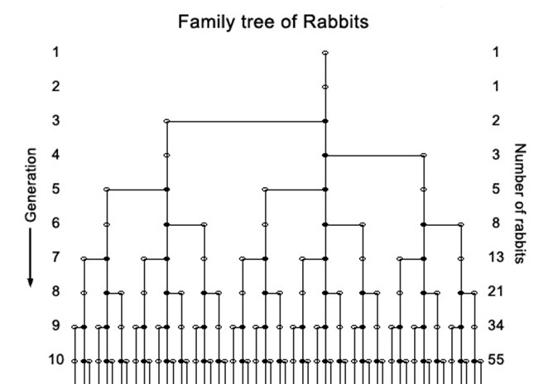
What’s Fibonacci Sequence?
The Fibonacci sequence is a type series where each number is the sum of the two that precede it. It starts from 0 and 1 usually. The Fibonacci sequence is given by 0, 1, 1, 2, 3, 5, 8, 13, 21, 34, 55, 89, 144, and so on.
Virahanka (6th-8th Century CE) and Hemachandra (12th Century) were ancient Indian scholars who independently described the sequence now known as the Fibonacci sequence, long before Leonardo of Pisa (Fibonacci).
In this image, each square’s side length matches a Fibonacci number. When arranged together, they form a spiral shape seen in nature, art, and architecture.
The spiral, overlaid on the squares, shows how rapidly the sequence grows and how it connects to the famous “golden ratio.”
The Fibonacci sequence is more than numbers: it appears in sunflower seeds, pinecones, and even the shape of galaxies. Understanding this pattern reveals the hidden math in our world.
The Indian mathematician and poet Pingala, around the 2nd-3rd century BCE, is known for describing the Fibonacci sequence in his work Chandaḥśāstra(चंडशास्त्र)
Formula:
Fn=Fn-1+Fn-2
0, 1, 1, 2, 3, 5, 8, 13, 21, 34, 55, 89, 144, 233, 377, 610, 987, 1597, 2584, 4181
By Shreyy Vinay Madgaonkar
Class:X Roll no:06
Fibonacci wrote Liber Abaci to introduce the Hindu-Arabic numeral system (0-9) to Europe, proving it was a far more efficient tool for merchants and mathematicians than the cumbersome Roman numeral system.
The "rabbit problem" is one of the most famous applications of the Fibonacci sequence, first introduced by Leonardo of Pisa, known as Fibonacci, in his book Liber Abaci (1202).

Slide 4

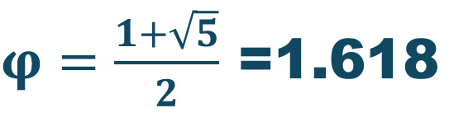
Fibonacci wrote Liber Abaci to introduce the Hindu-Arabic numeral system (0-9) to Europe, proving it was a far more efficient tool for merchants and mathematicians than the cumbersome Roman numeral system.
The "rabbit problem" is one of the most famous applications of the Fibonacci sequence, first introduced by Leonardo of Pisa, known as Fibonacci, in his book Liber Abaci (1202).
In this image, each square’s side length matches a Fibonacci number. When arranged together, they form a spiral shape seen in nature, art, and architecture.
The spiral, overlaid on the squares, shows how rapidly the sequence grows and how it connects to the famous “golden ratio.”
The Fibonacci sequence is more than numbers: it appears in sunflower seeds, pinecones, and even the shape of galaxies. Understanding this pattern reveals the hidden math in our world.
5x5 cm
8x5 cm
Formula:
Fn=Fn-1+Fn-2
Formula:
Fn=Fn-1
By Shreyy Vinay Madgaonkar
Class:X Roll no:06
$φ=\frac{1+\sqrt{5}}{2}$ =1.618
Rectangles that are in the golden ratio have side lengths in the special proportion of approximately 1.618 to 1, known as the golden ratio (denoted by the Greek letter φφ).Feature of golden rectangles is their self-similarity: if you remove a square from one end, the remaining smaller rectangle is also a golden rectangle with the same proportions
What’s Golden Rectangle?
A golden rectangle is a rectangle whose side lengths are in the golden ratio, which is approximately 1.618 which is denoted by Geek letter $φ$(Phi) . This special geometric shape exhibits

Slide 5
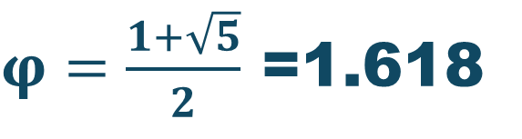

Fibonacci wrote Liber Abaci to introduce the Hindu-Arabic numeral system (0-9) to Europe, proving it was a far more efficient tool for merchants and mathematicians than the cumbersome Roman numeral system.
The "rabbit problem" is one of the most famous applications of the Fibonacci sequence, first introduced by Leonardo of Pisa, known as Fibonacci, in his book Liber Abaci (1202).
What’s Golden Rectangle?
In this image, each square’s side length matches a Fibonacci number. When arranged together, they form a spiral shape seen in nature, art, and architecture.
The spiral, overlaid on the squares, shows how rapidly the sequence grows and how it connects to the famous “golden ratio.”
The Fibonacci sequence is more than numbers: it appears in sunflower seeds, pinecones, and even the shape of galaxies. Understanding this pattern reveals the hidden math in our world.
A golden rectangle is a rectangle whose side lengths are in the golden ratio, which is approximately 1.618 which is denoted by Geek letter $φ$(Phi) . This special geometric shape exhibits
$φ=\frac{1+\sqrt{5}}{2}$ =1.618
5x5 cm
8x5 cm
Formula:
Fn=Fn-1+Fn-2
Formula:
Fn=Fn-1
By Shreyy Vinay Madgaonkar
Class:X Roll no:06
Rectangles that are in the golden ratio have side lengths in the special proportion of approximately 1.618 to 1, known as the golden ratio (denoted by the Greek letter φφ).Feature of golden rectangles is their self-similarity: if you remove a square from one end, the remaining smaller rectangle is also a golden rectangle with the same proportions

Slide 6

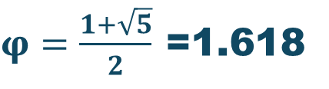
What’s Golden Rectangle?
A golden rectangle is a rectangle whose side lengths are in the golden ratio, which is approximately 1.618 which is denoted by Geek letter $φ$(Phi) . This special geometric shape exhibits
Rectangles that are in the golden ratio have side lengths in the special proportion of approximately 1.618 to 1, known as the golden ratio (denoted by the Greek letter φφ).Feature of golden rectangles is their self-similarity: if you remove a square from one end, the remaining smaller rectangle is also a golden rectangle with the same proportions
8x5 cm
5x5 cm
$φ=\frac{1+\sqrt{5}}{2}$ =1.618

Slide 7
Rectangles that are in the golden ratio have side lengths in the special proportion of approximately 1.618 to 1, known as the golden ratio (denoted by the Greek letter φφ).Feature of golden rectangles is their self-similarity: if you remove a square from one end, the remaining smaller rectangle is also a golden rectangle with the same proportions
13x8 cm
8x5 cm
5x3 cm
3x2 cm
2x1 cm
8x5 cm
5x5 cm
3x5 cm
$φ=\frac{1+\sqrt{5}}{2}$ =1.618
1
1.6
55 / 34 ≈ 1.6177 13/8 = 1.625 8/5 = 1.6 5/3 = 1.6666 3/2 = 1.5 2/1 = 2

Slide 8
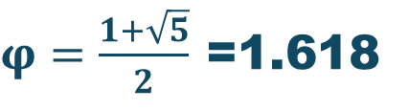
Rectangles that are in the golden ratio have side lengths in the special proportion of approximately 1.618 to 1, known as the golden ratio (denoted by the Greek letter φφ).Feature of golden rectangles is their self-similarity: if you remove a square from one end, the remaining smaller rectangle is also a golden rectangle with the same proportions
55 / 34 ≈ 1.6177 13/8 = 1.625 8/5 = 1.6 5/3 = 1.6666 3/2 = 1.5 2/1 = 2
13x8 cm
8x5 cm
5x3 cm
3x2 cm
2x1 cm
8x5 cm
5x5 cm
Formula:
Fn=Fn-1
3x5 cm
$φ=\frac{1+\sqrt{5}}{2}$ =1.618
Where the world used The Golden Rectangle?

Slide 9








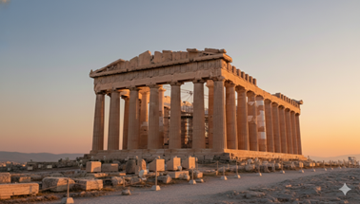
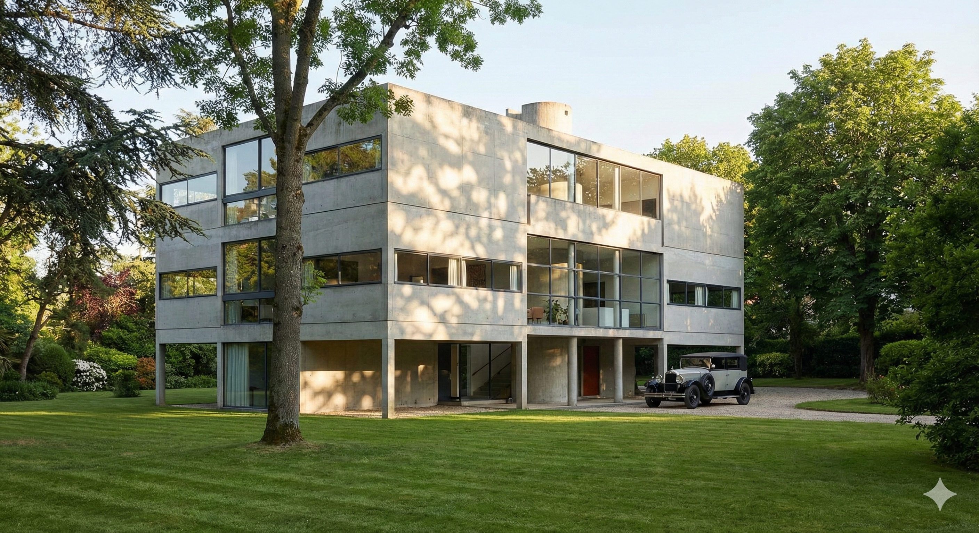
Rectangles that are in the golden ratio have side lengths in the special proportion of approximately 1.618 to 1, known as the golden ratio (denoted by the Greek letter φφ).Feature of golden rectangles is their self-similarity: if you remove a square from one end, the remaining smaller rectangle is also a golden rectangle with the same proportions
55 / 34 ≈ 1.6177 13/8 = 1.625 8/5 = 1.6 5/3 = 1.6666 3/2 = 1.5 2/1 = 2
Where the world used The Golden Rectangle?
13x8 cm
8x5 cm
Arts
Nature
Architecture
5x3 cm
3x2 cm
2x1 cm
Parthenon, Greece: Facade and columns follow golden rectangles for harmonious design.
Villa Stein, France: Le Corbusier used golden rectangles in layout and windows.

Slide 10











Where the world used The Golden Rectangle?
Architecture
Parthenon, Greece: Facade and columns follow golden rectangles for harmonious design.
Villa Stein, France: Le Corbusier used golden rectangles in layout and windows.
Leonardo da Vinci: “louvere paris," and "Mona Lisa" use golden rectangles for balance.
Logo Design: Brands like Google had used golden rectangles in their logos.
Photography: The Golden spiral is fundamental principle used in professional photography composition to create naturally balanced and aesthetically pleasing
images.
Nature
Arts

Slide 11





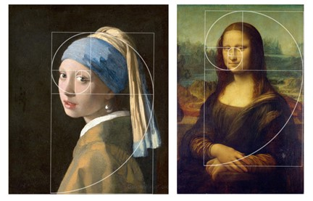
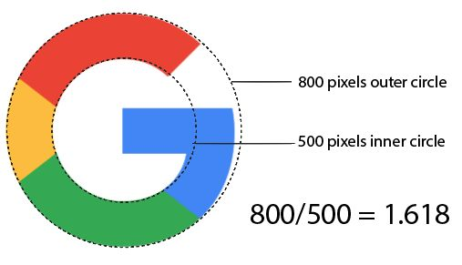
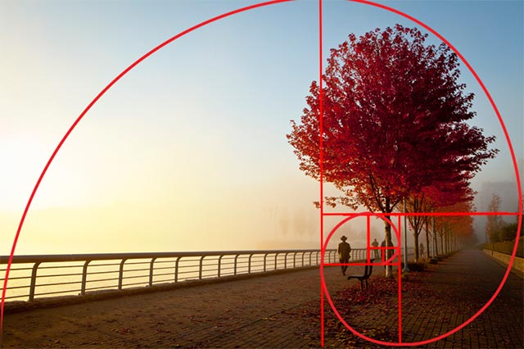





Architecture
Parthenon, Greece: Facade and columns follow golden rectangles for harmonious design.
Villa Stein, France: Le Corbusier used golden rectangles in layout and windows.
Where the world used The Golden Rectangle?
Arts
Leonardo da Vinci: “louvere paris," and "Mona Lisa" use golden rectangles for balance.
Logo Design: Brands like Google had used golden rectangles in their logos.
Photography: The Golden spiral is fundamental principle used in professional photography composition to create naturally balanced and aesthetically pleasing
images.
Nautilus and other shells: Spirals and growth reflect golden rectangle proportions.
Sunflower seeds, pinecones, flower petals: Spiral and arrangement patterns follow golden rectangle and Fibonacci Sequence
Galaxies: Spiral arms approximate a logarithmic spiral related to the golden ratio.
Nature

Slide 12
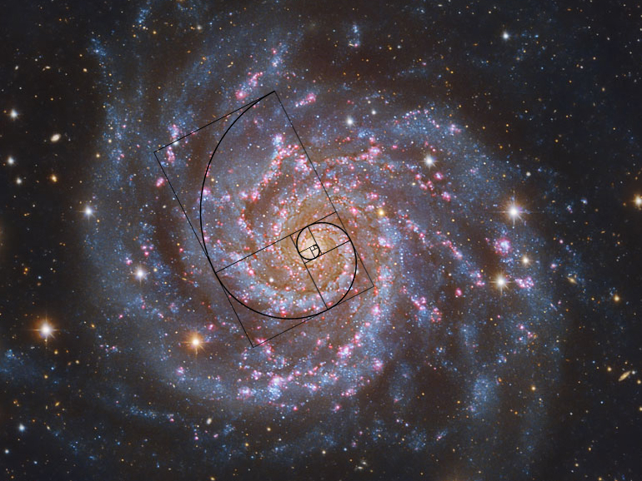


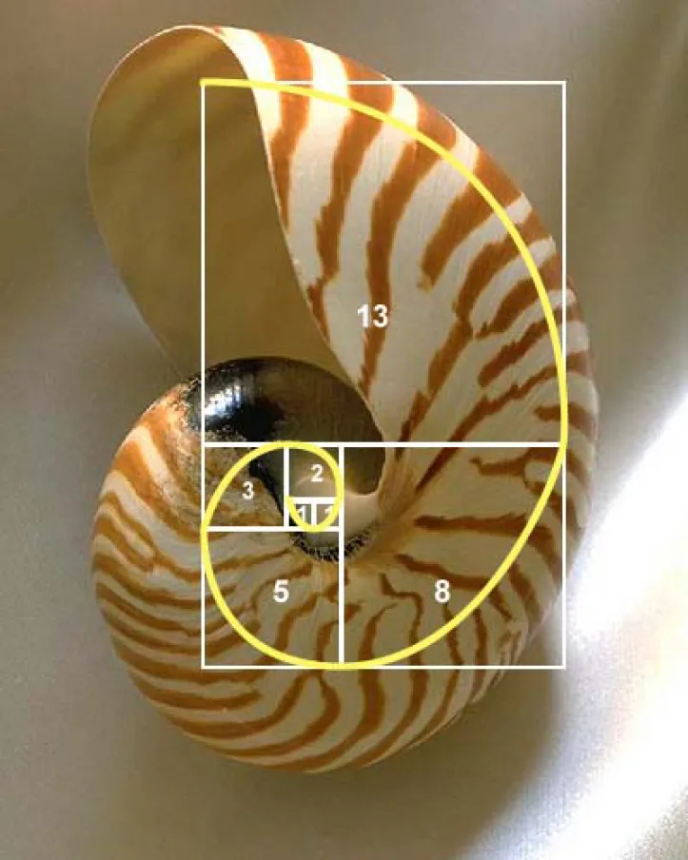
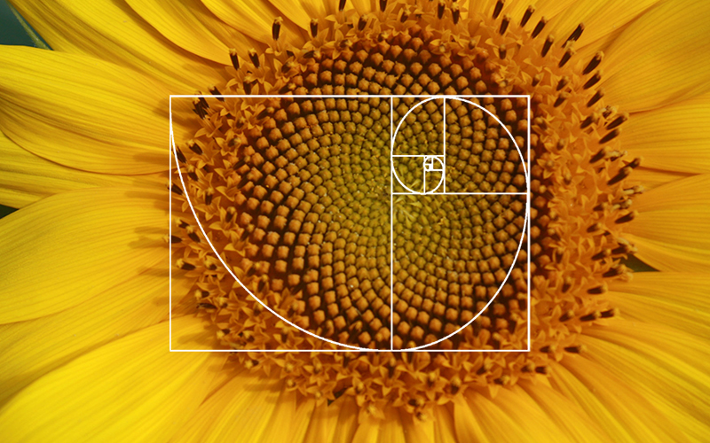


Arts
Leonardo da Vinci: “louvere paris," and "Mona Lisa" use golden rectangles for balance.
Logo Design: Brands like Google had used golden rectangles in their logos.
Where the world used The Golden Rectangle?
Nature
Nautilus and other shells: Spirals and growth reflect golden rectangle proportions.
Sunflower seeds, pinecones, flower petals: Spiral and arrangement patterns follow golden rectangle and Fibonacci Sequence
Galaxies: Spiral arms approximate a logarithmic spiral related to the golden ratio.

Slide 13
Nature
Nautilus and other shells: Spirals and growth reflect golden rectangle proportions.
Sunflower seeds, pinecones, flower petals: Spiral and arrangement patterns follow golden rectangle and Fibonacci Sequence
Galaxies: Spiral arms approximate a logarithmic spiral related to the golden ratio.
THANK YOU!

Slide 14
Nature
Nautilus and other shells: Spirals and growth reflect golden rectangle proportions.
Sunflower seeds, pinecones, flower petals: Spiral and arrangement patterns follow golden rectangle and Fibonacci Sequence
Galaxies: Spiral arms approximate a logarithmic spiral related to the golden ratio.
THANK YOU
Reference
Canva
YouTube
NotebookLM
Google

